Slide 1
CS 586 Project Report
Jiaqi Yan
jyan31@hawk.iit.edu
A20321362
Spring 2016
“When you are willing to make sacrifices for a great cause, you will never be alone.”

Slide 2
1. MDA-EFSM Model for the Account Components

Slide 3
1. MDA-EFSM Model for the Account Components

Slide 4
1. MDA-EFSM Model for the Account Components
As shown in the previous EFSM figure for model driven architecture, I choose to use the sample solution provided at Blackboard.
The list of meta events in the MDA-EFSM:
Open()
Login()
LoginFail()
Login()
IncorrectPin(int max)
CorrectPin()
AboveMin()
BelowMin()
Deposit()
Balance()
WithdrawFail()
Withdraw()
WithdrawBelowMin()
LockFail()
Lock()
UnlockFail()
Unlock()
Suspend()
Activate()
Close()
The list of meta actions in the MDA-EFSM:
StoreData(): store PIN, ID and balance data into DataStore
IncorrectIdMsg(): show “incorrect ID number” msg to user
IncorrectPinMsg(): show “incorrect PIN number” msg to user
TooManyAttemptMsg(): show “too many attempts” msg to user
DisplayMenu(): display menu on the console
DoDeposit(): deposit money into user’s account
DoWithdrawn(): withdraw money from user’s account
DisplayBalance(): display current account’s balance
PromptPin(): prompt for PIN number
NoFundMsg(): show “no sufficient money” msg to user
Penalty(): deduct penalty from user balance

Slide 5
1. MDA-EFSM Model for the Account Components
Pseudo-code of InputProcessors for Account1
void open(string p, string y, float a) {
data->temp_pin = p;
data->temp_id = y;
data->temp_b = a;
mda->Open()
}
void pin(string x) {
if (x == data->pin) {
mda->CorrectPin();
if (data->b > min_balance) {
mda->AboveMin();
} else {
mda->BelowMin();
}
} else {
mda->IncorrectPin(max_attempts);
}
}
void deposit(float d) {
data->temp_d = d;
mda->Deposit();
if (data->b > min_balance) {
mda->AboveMin();
} else {
mda->BelowMin();
}
}
void withdraw(float w) {
data->temp_w = w;
if (data->b <= min_balance) {
mda->WithdrawFail()
} else {
mda->Withdraw();
}
if (data->b > min_balance) {
mda->AboveMin();
} else {
mda->BelowMin();
}
}
void balance() {
mda->Balance();
}
void logout() {
mda->Logout();
}
void lock(string x) {
if (x == data->pin) {
mda->Lock();
} else {
mda->LockFail();
}
}
void login(string y) {
if (y == data->id) {
mda->Login();
} else {
mda->LoginFail();
}
}
void unlock(string x) {
if (x == data->pin) {
mda->Unlock();
if (data->b > min_balance) {
mda->AboveMin();
} else {
mda->BelowMin();
}
} else {
mda->UnlockFail();
}
}
max_attempts = 3;
min_balance = 500;

Slide 6
1. MDA-EFSM Model for the Account Components
Pseudo-code of InputProcessors for Account2
void OPEN(int p, int y, int a) {
data->temp_pin = p;
data->temp_id = y;
data->temp_b = a;
mda->Open();
}
void Account2::PIN(int x) {
if (x == data->pin) {
mda->CorrectPin();
mda->AboveMin();
} else {
mda->IncorrectPin(max_attempts);
}
}
void Account2::BALANCE() {
mda->Balance();
}
void Account2::LOGIN(int y) {
if (y == data->id) {
mda->Login();
} else {
mda->LoginFail();
}
}
void Account2::LOGOUT() {
mda->Logout();
}
void Account2::WITHDRAW(int w) {
data->temp_w = w;
if (data->b > min_balance) {
mda->Withdraw();
mda->AboveMin();
} else {
mda->WithdrawFail();
}
}
void Account2::suspend() {
mda->Suspend();
}
void Account2::activate() {
mda->Activate();
}
void Account2::close() {
mda->Close();
}
void Account2::DEPOSIT(int d) {
data->temp_d = d;
mda->Deposit();
mda->AboveMin();
}

Slide 7
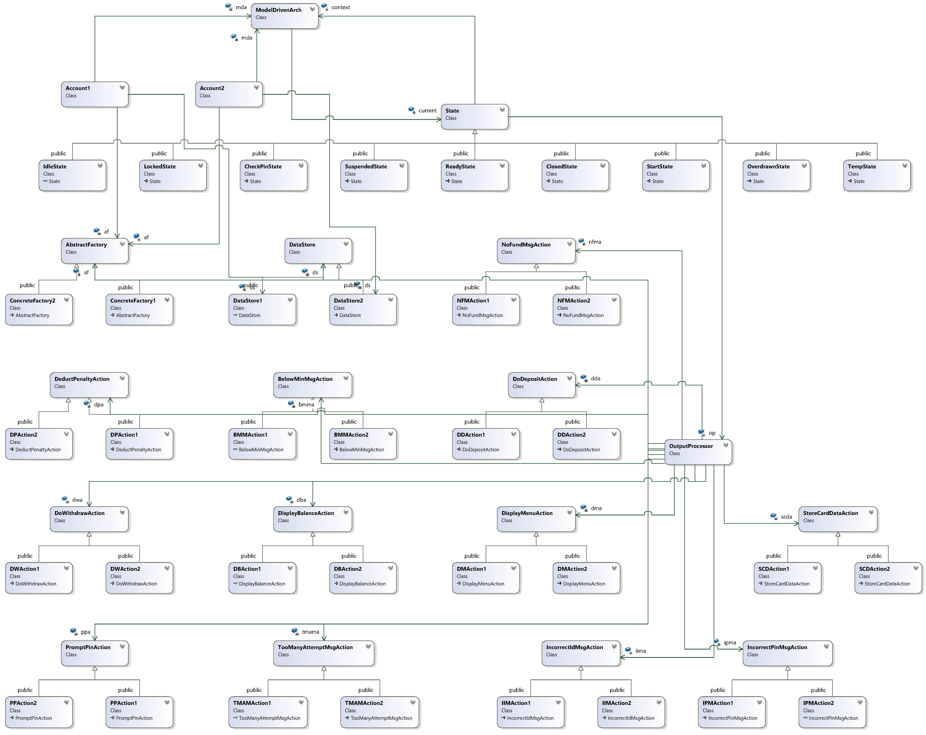
2. Class Diagrams of All Components
The overview architecture is drawn on the right. It just shows the general relationships between various of classes. 3 class design patterns group classes by their responsibilities. In the following sections, I will introduce the software design group by group. Classes in each design are described in detail.

Slide 8
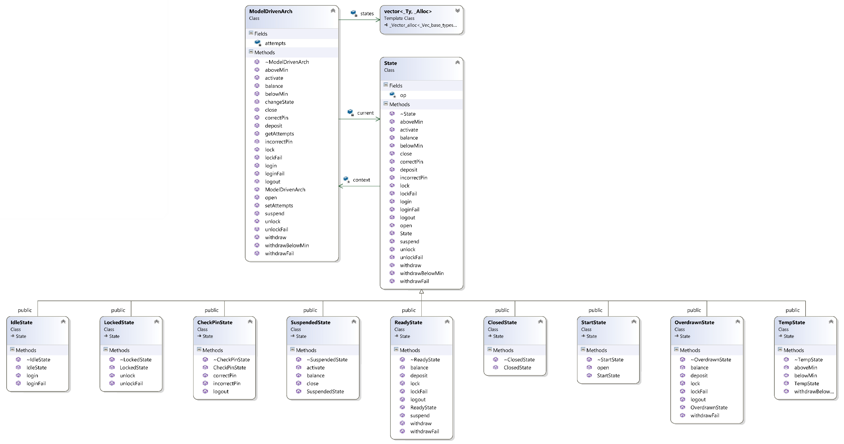
3. State Pattern
First, a zoomed and re-layouted diagram of state pattern is presented here. Details are given as follows.

Slide 9
3. State Pattern
Purpose, Attributes and Operations for State Pattern involved classes
Class ModelDrivenArch:
Purpose | Play the role of context class; keep tracking the current state in the EFSM; forward meta events to concrete states
Member variables | current: pointer to the object of current state attempts: number of incorrect PIN attempts states: a vector storing all state objects that appear in the state machine
Constructor | Create objects for each state in the state machine; store them in states; set current to StartState object
Destructor | Reclaim the objects in states
changeState(StateEnum id) | Used by State objects to change the current state of context
set/getAttempts() | Used by State objects to change/get the value of attempts
open() | Handle open event by calling current->open() | balance() | Handle balance event by calling current->balance()
login() | Handle login event by calling current->login() | withdraw() | Handle withdraw event by calling current->withdraw()
loginFail() | Handle loginFail event by calling current->loginFail() | withdrawFail() | Handle withdrawFail event by calling current->withdrawFail()
logout(int max) | Handle logout event by calling current->logout) | deposit() | Handle deposit event by calling current->deposit()
correctPin() | Handle correctPin event by calling current->correctPin() | lock() | Handle lock event by calling current->lock()
aboveMin() | Handle aboveMin event by calling current->aboveMin() | lockFail() | Handle lockFail event by calling current->lockFail()
belowMin() | Handle belowMin event by calling current->belowMin() | unlock() | Handle unlock event by calling current->unlock()
suspend() | Handle suspend event by calling current->suspend() | unlockFail() | Handle unlockFail event by calling current->unlockFail()
activate() | Handle activate event by calling current->activate() | close() | Handle close event by calling current->close()
incorrectPin(int max) | Handle incorrectPin event by calling current->incorrectPin(max) | withdrawBelowMin() | Handle withdrawBelowMin event by calling current->withdrawBelowMin()

Slide 10
3. State Pattern
Purpose, Attributes and Operations for State Pattern involved classes
Class: State
Purpose | Group all states appeared in the EFSM; define and provide default implementation of all event handler, e.g. do NOTHING
Member variables | context: pointer to the EFSM’s context, e.g. a ModelDrivenArch instance op: pointer to OutputProcessor instance for issuing action
Constructor | Initilize context and op with provided parameters
Destructor | No need to do anything
open() | Virtual function overridden by subclasses, empty operation | balance() | Virtual function overridden by subclasses, empty operation
login() | Virtual function overridden by subclasses, empty operation | withdraw() | Virtual function overridden by subclasses, empty operation
loginFail() | Virtual function overridden by subclasses, empty operation | withdrawFail() | Virtual function overridden by subclasses, empty operation
logout(int max) | Virtual function overridden by subclasses, empty operation | deposit() | Virtual function overridden by subclasses, empty operation
correctPin() | Virtual function overridden by subclasses, empty operation | lock() | Virtual function overridden by subclasses, empty operation
aboveMin() | Virtual function overridden by subclasses, empty operation | lockFail() | Virtual function overridden by subclasses, empty operation
belowMin() | Virtual function overridden by subclasses, empty operation | unlock() | Virtual function overridden by subclasses, empty operation
suspend() | Virtual function overridden by subclasses, empty operation | unlockFail() | Virtual function overridden by subclasses, empty operation
activate() | Virtual function overridden by subclasses, empty operation | close() | Virtual function overridden by subclasses, empty operation
incorrectPin(int max) | Virtual function overridden by subclasses, empty operation | withdrawBelowMin() | Virtual function overridden by subclasses, empty operation

Slide 11
3. State Pattern
Purpose, Attributes and Operations for State Pattern involved classes
Class: StartState
Purpose | Represent the Start state in EFSM; handle open event when current state is Start
Member variables | Inherit context and op from base class State
open() | Change current to Idle state, issue StoreData action to OutputProcessor op
Class: IdelState
Purpose | Represent the Idle state in EFSM; handle login and loginFail events when current state is Idle
Member variables | Inherit context and op from base class State
login() | Change current to CheckPin state, set context’s attempts to 0, issue PromptPin action to OutputProcessor op
loginFail() | Issue IncorrectIdMsg to OutputProcessor op
Class: CheckPinState
Purpose | Represent the CheckPin state in EFSM; handle correctPin, incorrectPin and logout events when current state is CheckPin
Member variables | Inherit context and op from base class State
correctPin() | Change current to Temp state, issue DisplayMenu action to OutputProcessor op
incorrectPin(int max) | If attempts >= max, reduce to Idle state and issue TooManyAttemptMsg action to OutputProcessor op; otherwise, increase context’s attempts by one and issue IncorrectPinMsg action to OutputProcessor op
logout() | Change current to Idle state

Slide 12
3. State Pattern
Purpose, Attributes and Operations for State Pattern involved classes
Class: ReadyState
Purpose | Represent the Ready state in EFSM; handle events illustrated in the EFSM figure
Member variables | Inherit context and op from base class State
balance() | Issue DisplayBalance action to OutputProcessor op
lockFail() | Issue IncorrectPinMsg action to OutputProcessor op
lock() | Change current to Locked state
suspend() | Change current to Suspended state
withdrawFail() | Issue NoFundMsg action to OutputProcessor op
withdraw() | Change current to Temp state, issue DoWithdraw action to OutputProcessor op
deposit() | Issue DoDeposit action to OutputProcessor op
logout() | Change current to Idle state

Slide 13
3. State Pattern
Purpose, Attributes and Operations for State Pattern involved classes
Class: OverdrawnState
Purpose | Represent the Overdrawn state in EFSM; handle events illustrated in the EFSM figure
Member variables | Inherit context and op from base class State
balance() | Issue DisplayBalance action to OutputProcessor op
lockFail() | Issue IncorrectPinMsg action to OutputProcessor op
lock() | Change current to Locked state
withdrawFail() | Issue BelowMinMsg action to OutputProcessor op
deposit() | Change current to Temp state, issue DoDeposit action to OutputProcessor op
logout() | Change current to Idle state
Class: LockedState
Purpose | Represent the Locked state in EFSM; handle unlock and unlockFail events when current state is Idle
Member variables | Inherit context and op from base class State
unlock() | Change current to Temp state
unlockFail() | Issue IncorrectPinMsg to OutputProcessor op

Slide 14
3. State Pattern
Purpose, Attributes and Operations for State Pattern involved classes
Class: SuspendedState
Purpose | Represent the Suspended state in EFSM; handle activate, balance and close events illustrated in the EFSM figure
Member variables | Inherit context and op from base class State
balance() | Issue DisplayBalance action to OutputProcessor op
activate() | Change current to Ready state
close() | Change current to Closed state
Class: TempState
Purpose | Represent the Temp state in EFSM; handle aboveMin, belowMin and withdrawBelowMin events when current state is Idle
Member variables | Inherit context and op from base class State
aboveMin() | Change current to Ready state
belowMin() | Change current to Overdrawn state
withdrawBelowMin() | Change current to Overdrawn state, issue Penalty action to OutputProcessor op

Slide 15
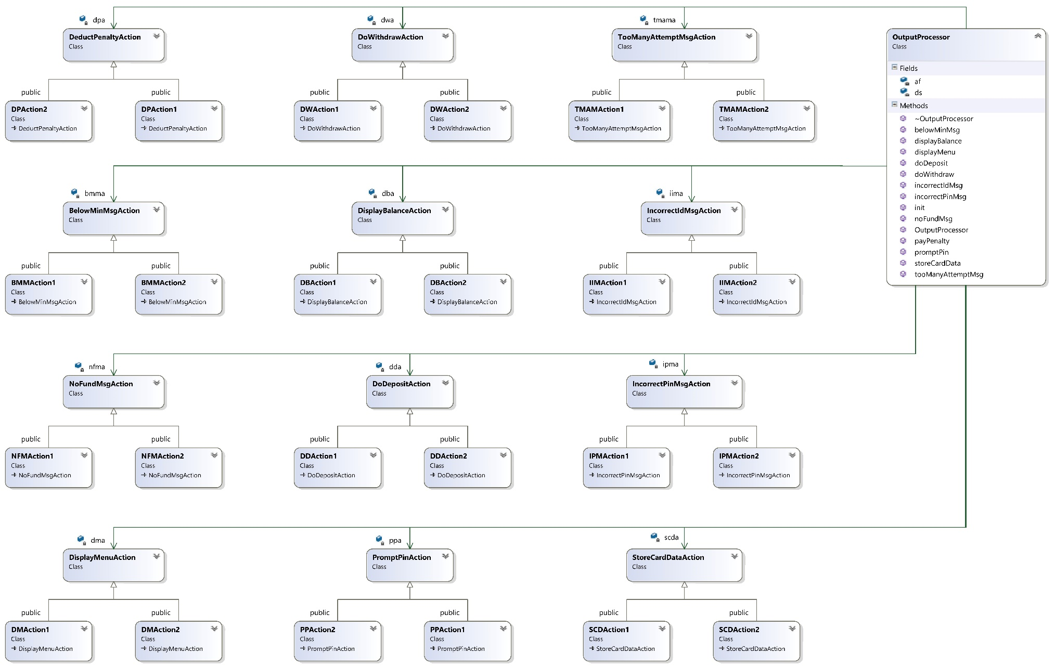
4. Strategy Pattern

Slide 16
4. Strategy Pattern
Purpose, Attributes and Operations for Strategy Pattern involved classes
Class: OutputProcessor
Purpose | Play the role of output processor in MDA architecture; as client of various action strategies, issue actions on each strategy’s base class
Member variables | ds: point to a DataStore object; some actions need a DataStore object to access data |  |  | dpa: pinter to DeductPenaltyAction strategy
 | sda: pointer to StoreDataAction strategy |  |  | ipma: pointer to IncorrectPinMsgAction strategy
 | iimp: pointer to IncorrectIdMsgAction strategy |  |  | tmama: pointer to TooManyAttmeptAction strategy
 | ppa: pointer to PromptPinAction strategy |  |  | dma: pointer to DisplayMenuAction strategy
 | dda: pointer to DoDepositAction strategy |  |  | nfma: pointer to NoFundMsaAction strategy
 | dba: pointer to DoWithdrawAction strategy |  |  | bmma: pointer to BelowMinMsgAction strategy
 | af: Abstract factory instance used to create/configure all the previous pointers
Constructor(AbstractFacotry *af) | Initialize af with a concrete factory | Destructor() |  |  |  | Do nothing
init() | Create/configure DataStore object and action strategies using af, see Abstract Factory Pattern for details
storeData() | Forward action by invoking sda->storeData() |  | doDeposit() |  | Forward action by invoking dda->doDeposit()
incorrecePinMsg() | Forward action by invoking ipma>incorrecePinMsg() |  | noFundMsg() |  | Forward action by invoking nfma->noFundMsg()
incorrectIdMsg() | Forward action by invoking iima->incorrecePinMsg() |  | displayBalance() |  | Forward action by invoking dba->displayBalance()
tooManyAttemptMsg() | Forward action by invoking tmama->tooManyAttemptMsg() |  | doWithdraw() |  | Forward action by invoking dwm->doWithdraw()
promptPin() | Forward action by invoking ppa->promptPin() |  | belowMinMsg() |  | Forward action by invoking bmma->belowMinMsg()
displayMenu() | Forward action by invoking dma->displayMenu() |  | payPenalty() |  | Forward action by invoking dpa->payPenalty()

Slide 17
4. Strategy Pattern
Purpose, Attributes and Operations for Strategy Pattern involved classes
Class: StoreDataAction
Purpose | Abstract class that groups strategies of StoreData action
Member variables | None
Constructor/Destructor() | Do nothing
storeData(DataStore *ds) | Abstract method; subclass should override it to store temp_pin, temp_id and temp_balance to pin, id and balance respectively; different strategies differs in the type of DataStore
Class: SDAction1
Purpose | Concrete strategy of StoreData action for Account1
Member variables | None
Constructor/Destructor() | Do nothing
storeData(DataStore *ds) | Cast ds to DataStore1 object and execute the store action
Class: SDAction2
Purpose | Concrete strategy of StoreData action for Account2
Member variables | None
Constructor/Destructor() | Do nothing
storeData(DataStore *ds) | Cast ds to DataStore2 object and execute the store action

Slide 18
4. Strategy Pattern
Purpose, Attributes and Operations for Strategy Pattern involved classes
Class: IncorrectPinMsgAction
Purpose | Abstract class that groups strategies of IncorrectPinMsg action
Member variables | None
Constructor/Destructor() | Do nothing
incorrectPinMsg() | Abstract method; override to print out msg about incorrect PIN number for different accounts
Class: IPMAction1
Purpose | Concrete strategy of IncorrectPinMsg action for Account1
Member variables | None
Constructor/Destructor() | Do nothing
incorrectPinMsg() | Print out incorrect PIN msg for account1
Class: IPMAction2
Purpose | Concrete strategy of IncorrectPinMsg action for Account2
Member variables | None
Constructor/Destructor() | Do nothing
incorrectPinMsg() | Print out incorrect PIN msg for account2

Slide 19
4. Strategy Pattern
Purpose, Attributes and Operations for Strategy Pattern involved classes
Class: IncorrectIdMsgAction
Purpose | Abstract class that groups strategies of IncorrectIdMsg action
Member variables | None
Constructor/Destructor() | Do nothing
incorrectIdMsg() | Abstract method; override to print out msg about incorrect ID number for different accounts
Class: IIMAction1
Purpose | Concrete strategy of IncorrectIdMsg action for Account1
Member variables | None
Constructor/Destructor() | Do nothing
incorrectIdMsg() | Print out incorrect ID msg for account1
Class: IIMAction2
Purpose | Concrete strategy of IncorrectIdMsg action for Account2
Member variables | None
Constructor/Destructor() | Do nothing
incorrectIdMsg() | Print out incorrect ID msg for account2

Slide 20
4. Strategy Pattern
Purpose, Attributes and Operations for Strategy Pattern involved classes
Class: TooManyAttemptMsgAction
Purpose | Abstract class that groups strategies of TooManyAttemptMsg action
Member variables | None
Constructor/Destructor() | Do nothing
tooManyAttemptMsg() | Abstract method; override to print out msg about “too many incorrect PIN number” for different accounts
Class: TMAMAction1
Purpose | Concrete strategy of TooManyAttemptMsg action for Account1
Member variables | None
Constructor/Destructor() | Do nothing
tooManyAttemptMsg() | Print out too many incorrect PIN number msg for account1
Class: TMAMAction2
Purpose | Concrete strategy of TooManyAttemptMsg action for Account2
Member variables | None
Constructor/Destructor() | Do nothing
tooManyAttemptMsg() | Print out too many incorrect PIN number msg for account2

Slide 21
4. Strategy Pattern
Purpose, Attributes and Operations for Strategy Pattern involved classes
Class: PromptPinAction
Purpose | Abstract class that groups strategies of PromptPin action
Member variables | None
Constructor/Destructor() | Do nothing
promptPin() | Abstract method; override to print out msg about “please input PIN number” for different accounts
Class: PPAction1
Purpose | Concrete strategy of PromptPin action for Account1
Member variables | None
Constructor/Destructor() | Do nothing
promptPin() | Print out “please input PIN number” msg for account1
Class: PPAction2
Purpose | Concrete strategy of PromptPin action for Account2
Member variables | None
Constructor/Destructor() | Do nothing
promptPin() | Print out “please input PIN number” msg for account2

Slide 22
4. Strategy Pattern
Purpose, Attributes and Operations for Strategy Pattern involved classes
Class: DisplayMenuAction
Purpose | Abstract class that groups strategies of DisplayMenu action
Member variables | None
Constructor/Destructor() | Do nothing
displayMenu() | Abstract method; override to print menu for different accounts
Class: DMAction1
Purpose | Concrete strategy of DisplayMenu action for Account1
Member variables | None
Constructor/Destructor() | Do nothing
displayMenu() | Print out menu for account1
Class: DMAction2
Purpose | Concrete strategy of DisplayMenu action for Account2
Member variables | None
Constructor/Destructor() | Do nothing
displayMenu() | Print out menu for account2

Slide 23
4. Strategy Pattern
Purpose, Attributes and Operations for Strategy Pattern involved classes
Class: DoDepositAction
Purpose | Abstract class that groups strategies of DoDeposit action
Member variables | None
Constructor/Destructor() | Do nothing
doDeposit(DataStore *ds) | Abstract method; override to make deposit with temp_d and balance in DataStore
Class: DDAction1
Purpose | Concrete strategy of DoDeposit action for Account1
Member variables | None
Constructor/Destructor() | Do nothing
doDeposit(DataStore *ds) | Make deposit by adding temp_d and balance in DataStore
Class: DDAction2
Purpose | Concrete strategy of DoDeposit action for Account2
Member variables | None
Constructor/Destructor() | Do nothing
doDeposit(DataStore *ds) | Make deposit by adding temp_d and balance in DataStore

Slide 24
4. Strategy Pattern
Purpose, Attributes and Operations for Strategy Pattern involved classes
Class: NoFundMsgAction
Purpose | Abstract class that groups strategies of NoFundMsg action
Member variables | None
Constructor/Destructor() | Do nothing
noFundMsg() | Abstract method; override to prompt msg about insufficient fund
Class: NFMAction1
Purpose | Concrete strategy of NoFundMsg action for Account1
Member variables | None
Constructor/Destructor() | Do nothing
doDeposit() | Prompt msg about insufficient fund
Class: NFMAction2
Purpose | Concrete strategy of NoFundMsg action for Account2
Member variables | None
Constructor/Destructor() | Do nothing
doDeposit() | Prompt msg about insufficient fund

Slide 25
4. Strategy Pattern
Purpose, Attributes and Operations for Strategy Pattern involved classes
Class: DisplayBalanceAction
Purpose | Abstract class that groups strategies of DisplayBalance action
Member variables | None
Constructor/Destructor() | Do nothing
displayBalance(DataStore *ds) | Abstract method; override to display current balance for different accounts
Class: DBAction1
Purpose | Concrete strategy of DisplayBalance action for Account1
Member variables | None
Constructor/Destructor() | Do nothing
displayBalance(DataStore *ds) | display current balance for account 1
Class: DBAction2
Purpose | Concrete strategy of DisplayBalance action for Account2
Member variables | None
Constructor/Destructor() | Do nothing
displayBalance(DataStore *ds) | display current balance for account 2

Slide 26
4. Strategy Pattern
Purpose, Attributes and Operations for Strategy Pattern involved classes
Class: DoWithdrawAction
Purpose | Abstract class that groups strategies of DoWithdraw action
Member variables | None
Constructor/Destructor() | Do nothing
doWithdraw(DataStore *ds) | Abstract method; override to make withdraw from temp_w from balance
Class: DWAction1
Purpose | Concrete strategy of DoWithdraw action for Account1
Member variables | None
Constructor/Destructor() | Do nothing
doWithdraw(DataStore *ds) | Make withdraw from temp_w from balance
Class: DWAction2
Purpose | Concrete strategy of DoWithdraw action for Account2
Member variables | None
Constructor/Destructor() | Do nothing
doWithdraw(DataStore *ds) | Make withdraw from temp_w from balance

Slide 27
4. Strategy Pattern
Purpose, Attributes and Operations for Strategy Pattern involved classes
Class: BelowMinMsgAction
Purpose | Abstract class that groups strategies of BelowMinMsg action
Member variables | None
Constructor/Destructor() | Do nothing
belowMinMsg() | Abstract method; override to print out msg about below minimum balance
Class: DWAction1
Purpose | Concrete strategy of BelowMinMsg action for Account1
Member variables | None
Constructor/Destructor() | Do nothing
belowMinMsg() | Print out msg about below minimum balance
Class: DWAction2
Purpose | Concrete strategy of BelowMinMsg action for Account2
Member variables | None
Constructor/Destructor() | Do nothing
belowMinMsg() | Print out msg about below minimum balance

Slide 28
4. Strategy Pattern
Purpose, Attributes and Operations for Strategy Pattern involved classes
Class: DeductPenaltyAction
Purpose | Abstract class that groups strategies of DeductPenalty action
Member variables | penalty: amount of penalty to pay for different accounts
Constructor/Destructor() | Do nothing
payPenalty(DataStore *ds) | Abstract method; override to deduct penalty from balance
Class: DPAction1
Purpose | Concrete strategy of BelowMinMsg action for Account1
Member variables | Inherit penalty from base class
Constructor/Destructor() | Do nothing
payPenalty(DataStore *ds) | Deduct penalty from balance, penalty for Account1 is 20
Class: DPAction2
Purpose | Concrete strategy of BelowMinMsg action for Account2
Member variables | Inherit penalty from base class
Constructor/Destructor() | Do nothing
payPenalty(DataStore *ds) | Deduct penalty from balance, penalty for Account2 is zero

Slide 29
5. Abstract Factory Pattern I – AbstractFactory
Class diagram of abstract factory pattern, showing the relation between abstract factory and its clients(InputProcessor and OutputProcessors), but without showing the relations between concrete factories and its products.

Slide 30
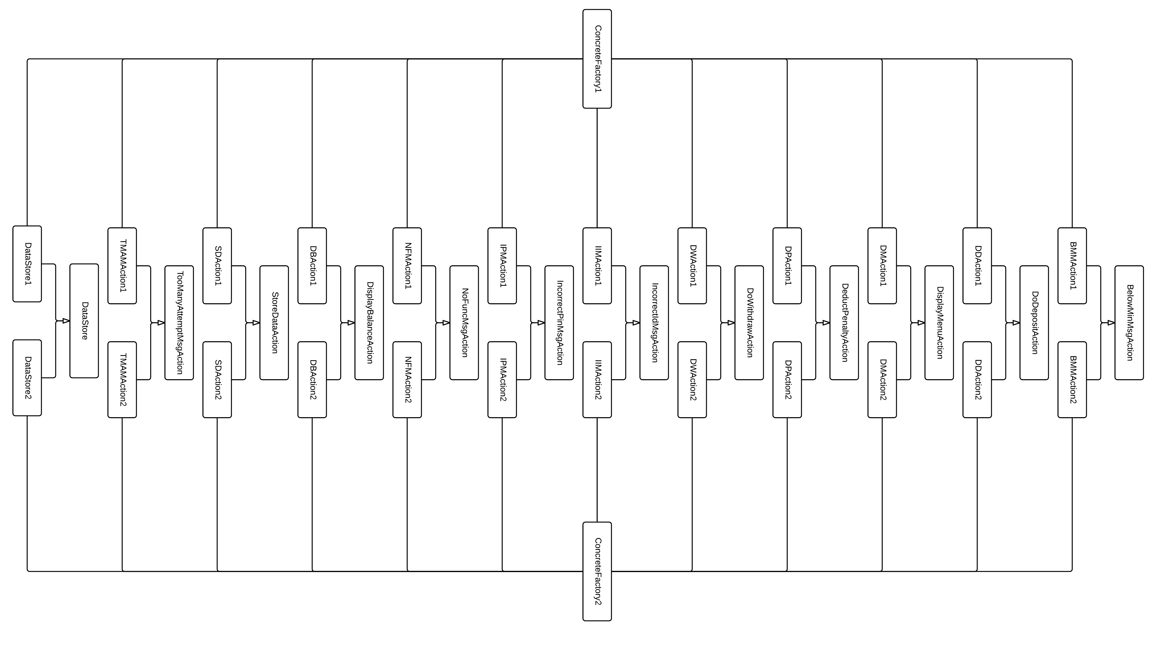
5. Abstract Factory Pattern II – Concrete Factories
Simplified class diagram of abstract factory pattern showing the relationships between concrete factories and its products.

Slide 31
5. Abstract Factory Pattern
Purpose, Attributes and Operations for Abstract Factory Pattern involved classes
Class: AbstractFactory
Purpose | Groups various of concrete factories for different clients (InputProcessors and OutpurProcessor)
Member variables Notice: since InputProcessor and OutputProcessor should operate on the same DataStore instance, AbstractFactory should only create 1 such object and cache it for later usage. | cacheDS: pointer to a DataStore object; | cacheDPA: pinter to DeductPenaltyAction strategy
 | cacheSDA: pointer to StoreDataAction strategy | cacheIPMA: pointer to IncorrectPinMsgAction strategy
 | cacheIIMP: pointer to IncorrectIdMsgAction strategy | cacheTMAMA: pointer to TooManyAttmeptAction strategy
 | cachePPA: pointer to PromptPinAction strategy | cacheDMA: pointer to DisplayMenuAction strategy
 | cacheDDA: pointer to DoDepositAction strategy | cacheNFMA: pointer to NoFundMsaAction strategy
 | cacheDWA: pointer to DoWithdrawAction strategy | cacheBMMA: pointer to BelowMinMsgAction strategy
Constructor() | Initialize all pointers above to NULL | Destructor() | Do nothing
createDS() | Abstract method returning DataStore instance to client
createSDA() | Abstract method returning StoreCardAction strategy | createDDA() | Abstract method returning DoDepositAction strategy
createIPMA() | Abstract method returning IncorrectPinMsgAction strategy | createNFMA() | Abstract method returning NoFundMsgAction strategy
createIIMA() | Abstract method returning IncorrectIdMsgAction strategy | createDBA() | Abstract method returning DisplayBalanceAciton strategy
createTMAMA() | Abstract method returning IncorrectIdMsgAction strategy | createDWA() | Abstract method returning DoWithdrawAction strategy
createPPA() | Abstract method returning PromptPinAciton strategy | createBMMA() | Abstract method returning BelowMinMsgAction strategy
createDMA() | Abstract method returning DisplayMenuAction strategy | createDPA() | Abstract method returning DeductPenaltyAction strategy

Slide 32
5. Abstract Factory Pattern
Purpose, Attributes and Operations for Abstract Factory Pattern involved classes
Class: ConcreteFactory1
Purpose | Concrete factory who create strategies and DataStore1 instance for Account1 and its paired OutputProcessor
Member variables | Cache pointers inherited from AbstractFactory base class
Constructor() | Do nothing (use base class’s constructor) | Destructor() | Do nothing
createDS() | Create DataStore1 instance, cache it before return it to client; thereafter return the cached instance
createSDA() | Create SDAction1 instance, cache it before return it to client; thereafter return the cached instance
createIPMA() | Create IPMAction1 instance, cache it before return it to client; thereafter return the cached instance
createIIMA() | Create IIMAction1 instance, cache it before return it to client; thereafter return the cached instance
createTMAMA() | Create TMAMAction1 instance, cache it before return it to client; thereafter return the cached instance
createPPA() | Create PPAction1 instance, cache it before return it to client; thereafter return the cached instance
createDMA() | Create DMAction1 instance, cache it before return it to client; thereafter return the cached instance
createDDA() | Create DDAction1 instance, cache it before return it to client; thereafter return the cached instance
createNFMA() | Create NFMAction1 instance, cache it before return it to client; thereafter return the cached instance
createDBA() | Create DBAction1 instance, cache it before return it to client; thereafter return the cached instance
createDWA() | Create DWAction1 instance, cache it before return it to client; thereafter return the cached instance
createBMMA() | Create BMMAction1 instance, cache it before return it to client; thereafter return the cached instance
createDPA() | Create DPAction1 instance, cache it before return it to client; thereafter return the cached instance

Slide 33
5. Abstract Factory Pattern
Purpose, Attributes and Operations for Abstract Factory Pattern involved classes
Class: ConcreteFactory1
Purpose | Concrete factory who create strategies and DataStore2 instance for Account2 and its paired OutputProcessor
Member variables | Cache pointers inherited from AbstractFactory base class
Constructor() | Do nothing (use base class’s constructor) | Destructor() | Do nothing
createDS() | Create DataStore2 instance, cache it before return it to client; thereafter return the cached instance
createSDA() | Create SDAction2 instance, cache it before return it to client; thereafter return the cached instance
createIPMA() | Create IPMAction2 instance, cache it before return it to client; thereafter return the cached instance
createIIMA() | Create IIMAction2 instance, cache it before return it to client; thereafter return the cached instance
createTMAMA() | Create TMAMAction2 instance, cache it before return it to client; thereafter return the cached instance
createPPA() | Create PPAction2 instance, cache it before return it to client; thereafter return the cached instance
createDMA() | Create DMAction2 instance, cache it before return it to client; thereafter return the cached instance
createDDA() | Create DDAction2 instance, cache it before return it to client; thereafter return the cached instance
createNFMA() | Create NFMAction2 instance, cache it before return it to client; thereafter return the cached instance
createDBA() | Create DBAction2 instance, cache it before return it to client; thereafter return the cached instance
createDWA() | Create DWAction2 instance, cache it before return it to client; thereafter return the cached instance
createBMMA() | Create BMMAction2 instance, cache it before return it to client; thereafter return the cached instance
createDPA() | Create DPAction2 instance, cache it before return it to client; thereafter return the cached instance

Slide 34
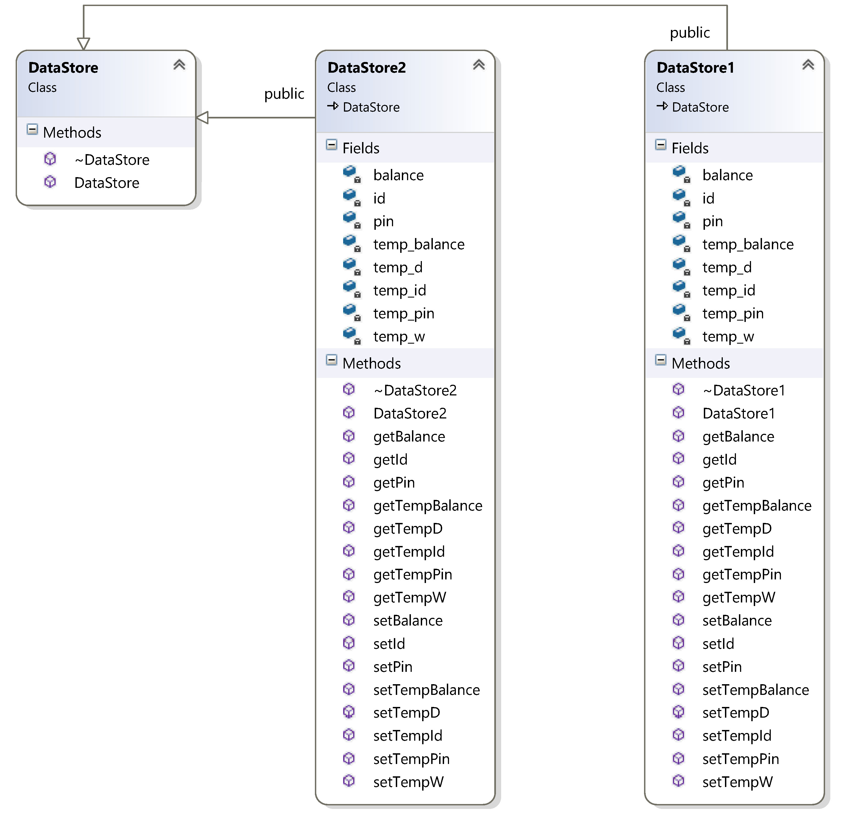
6. Details for Other Classes: DataStore

Slide 35
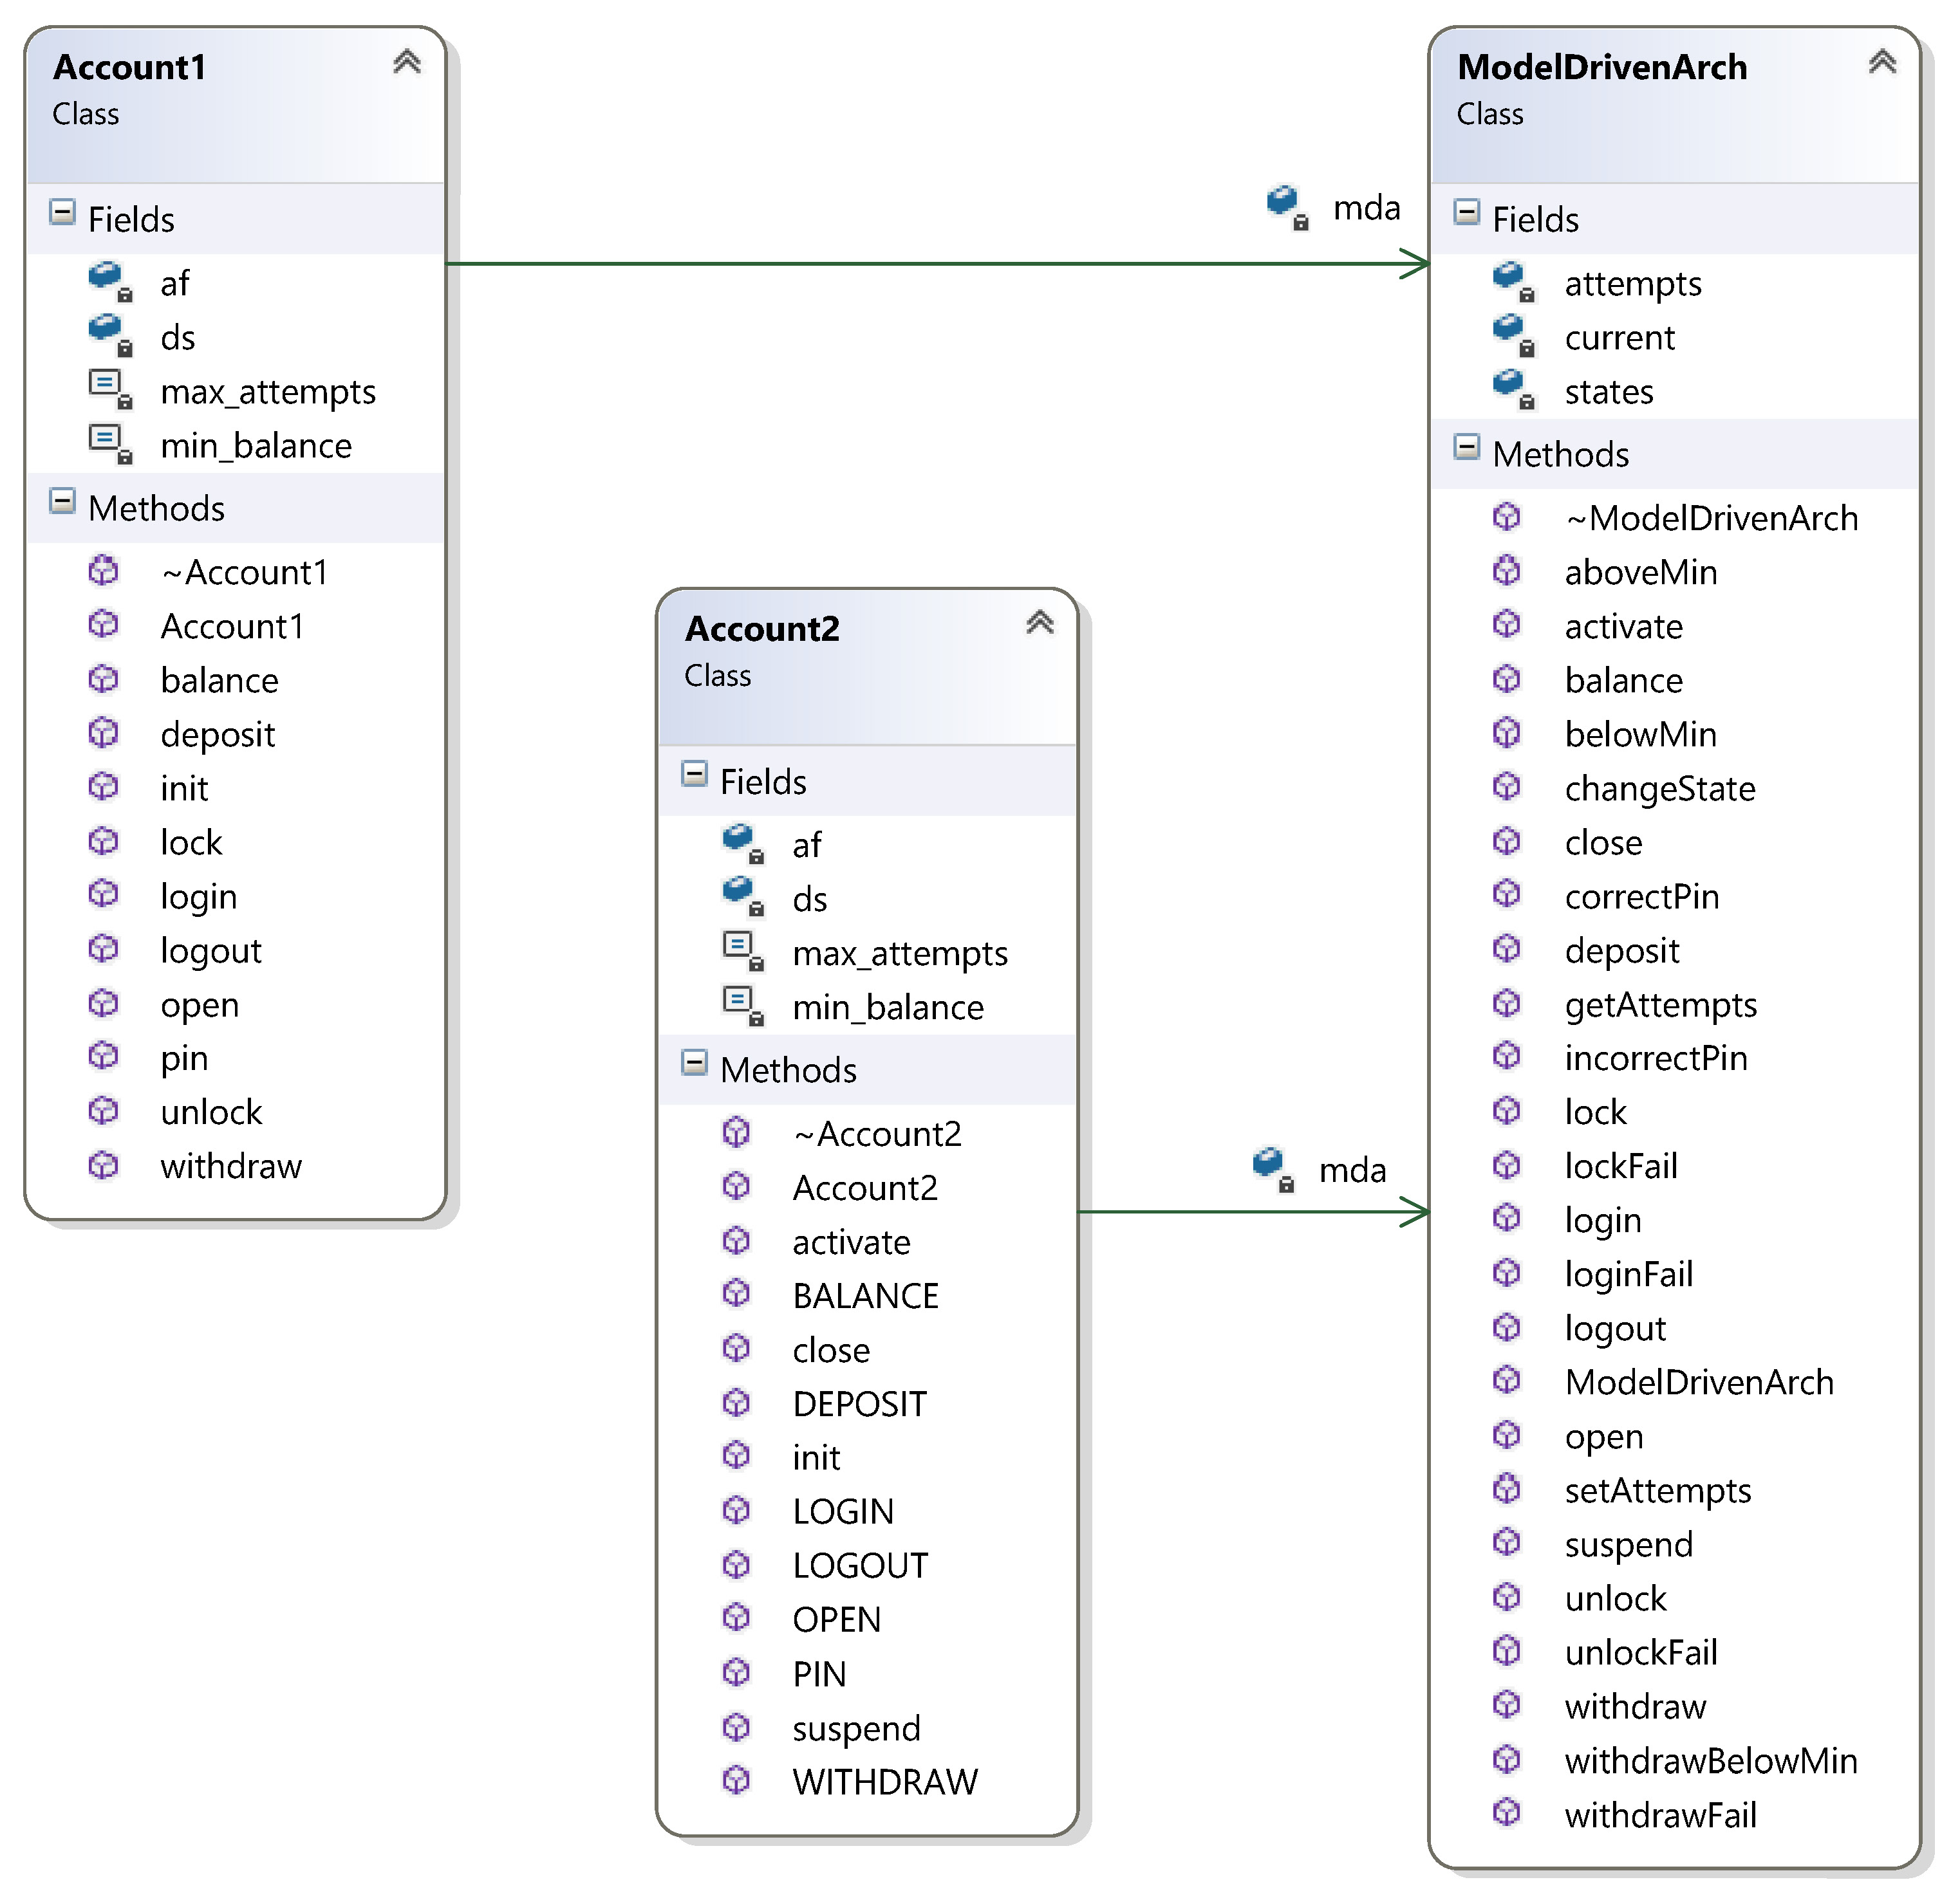
6. Details for Other Classes: Accounts
Class: Account1
Purpose | Play the role of InputProcessor in Model-driven architecture
Member variables | mda: pointer to ModelDrivenArch instance af: pointer to an AbstractFactory instance ds: pointer to its DataStore instance max_attempts: maximum number of incorrect PIN allowed min_balance: minimum balance amount
Constructor() | Initialize mda, af, max_attempts and min_balance
Destructor() | Reclaim/free DataStore1 object ds
Operations | Events in Account1-EFSM; each operation’s pseudo code is shown in section 1, page 5.
Class: Account2
Purpose | Play the role of InputProcessor in Model-driven architecture
Member variables | mda: pointer to ModelDrivenArch instance af: pointer to an AbstractFactory instance ds: pointer to its DataStore instance max_attempts: maximum number of incorrect PIN allowed min_balance: minimum balance amount
Constructor() | Initialize mda, af, max_attempts and min_balance
Destructor() | Reclaim/free DataStore2 object ds
Operations | Events in Account2-EFSM; each operation’s pseudo code is shown in section 1, page 6.

Slide 36
7. Dynamics for Two Scenarios
Scenario 1, open(abc, xyz, 100.5)

Slide 37
7. Dynamics for Two Scenarios
Scenario 1, login(xyz)

Slide 38
7. Dynamics for Two Scenarios
Scenario 1, pin(abc)

Slide 39
7. Dynamics for Two Scenarios
Scenario 1, deposit(400)

Slide 40
7. Dynamics for Two Scenarios
Scenario 1, balance()

Slide 41
7. Dynamics for Two Scenarios
Scenario 1, logout()

Slide 42
7. Dynamics for Two Scenarios
Scenario 2, OPEN()

Slide 43
7. Dynamics for Two Scenarios
Scenario 2, LOGIN()

Slide 44
7. Dynamics for Two Scenarios
Scenario 2, PIN(112)

Slide 45
7. Dynamics for Two Scenarios
Scenario 2, PIN(222)

Slide 46
7. Dynamics for Two Scenarios
Scenario 2, PIN(333)

Slide 47
8. Source Code and Patterns
State Pattern
State pattern is used for maintaining the state transition of MDA-EFSM. Its implementation locates at include/ModelDriveArch.hpp and src/ModelDriveArch.cpp. The classes involved in state pattern are:
ModelDrivenArch class: state machine context. since decentralized state pattern is used, this class delegate all events handling to the state classes.
State class: parent of all states class; it provides default event handling, e.g. do nothing.
Concrete state classes, including StartState, IdleState, CheckPinState, ReadyState, OverdrawnState, LockedState, SuspendedState, CloseState and TempState

Slide 48
8. Source Code and Patterns
Strategy Pattern
Strategy pattern groups the actions of different accounts. Its implementation locates at include/Actions.hpp and src/Actions.cpp. The classes involved in strategy pattern are:
Each meta action corresponds to an abstract strategy class, including StoreCardDataAction, IncorrectPinMsgAction, IncorrectIdMsgAction, TooManyAttemptMsgAction, PromptPinAction, DisplayMenuAction, DoDepositAction, NoFundMsgAction, DisplayBalanceAction, DoWithdrawAction, BelowMinMsgAction, DeductPenaltyAction
For each strategy, 2 concrete strategies are provided for either Account1 or Account2, including SCDAction1, SCDAction2, IPMAction1, IPMAction2, IIMAction1, IIMAction2, TMAMAction1, TMAMAction2, PPAction1, PPAction2, DMAction1, DMAction2, DDAction1, DDAction2, NFMAction1, NFMAction2, DBAction1, DBAction2, DWAction1, DWAction2, BMMAction1, BMMAction2, DPAction1, DPAction2
OutputProcessor: the client class of strategies

Slide 49
8. Source Code and Patterns
Abstract Factory Pattern
Abstract factory pattern ease the burden of create and configure strategies and data store for clients. Its implementation locates at include/AbstractFactory.hpp and src/AbstractFactory.cpp. Client of abstract factory are InputProcessors and Outprocessor, located at include/Accounts.hpp, includes/Actions.hpp, src/Accounts.cpp and src/Actions.cpp. The classes involved in strategy pattern are:
AbstractFactory class: defines the possible products could be created for its clients
ConcreteFactory1 and ConcreteFactory2 classes: concrete classes for Account1 and Account2 respectively.
Account1, Account2 and OutputProcessor classes: client of AbstractFactory
Concrete products created by concrete factories:
For Account1 and OutputProcessor: DataStore1, SCDAction1, IPMAction1, IIMAction1, TMAMAction1, PPAction1, DMAction1, DDAction1, NFMAction1, DBAction1, DWAction1, BMMAction1, DPAction1
For Account2 and OutputProcessor: DataStore2, SCDAction2, IPMAction2, IIMAction2, TMAMAction2, PPAction2, DMAction2, DDAction2, NFMAction2, DBAction2, DWAction2, BMMAction2, DPAction2

Slide 50
9. Source Code

Slide 51
Marriage to Martin Luther King
Where did Coretta and Martin meet?
Where did they live when they were first married?
Where did Martin Luther King work?

Slide 52
Starting the civil rights movement
What event in Montgomery, Alabama triggered the modern civil rights movement and how were the Kings involved?

Slide 53
Raising her children and using her gifts
How many children did Coretta Scott King have?
What were their names?
How did she use her background in music to support and further the civil rights movement?

Slide 54
Traveling to celebrate freedom
Make a timeline of the dates and places that Martin Luther and Coretta Scott King visited together to celebrate a country’s freedom, to honor the memory of an inspirational leader, and to accept a prestigious award.
Name of Event 1 | Name of Event 2 | Name of Event 3 | Name of Event 4 | Name of Event 5 | Name of Event 6 | Name of Event 7 | Name of Event 8
1st Date | 2nd Date | 3rd Date | 4th Date | 5th Date | 6th Date | 7th Date | 8th Date
Description of Event | Description of Event | Description of Event | Description of Event | Description of Event | Description of Event | Description of Event | Description of Event

Slide 55
Speaking out and taking a stand
Tell about the different places and times that Coretta Scott King spoke in public to take a stand against injustice and to support peace.

Slide 56
Coretta Scott King’s legacy
Describe the other organizations that Coretta Scott King established to further the cause of social justice in the United States and around the world.

